Slide 1
INVESTMENT ANALYSIS · LESSON 1
What is
investment?
什么是投资？
HANDOUT READY
01 / 21
Notes:
Students keep Handout Version 24 open throughout. Ask for a one-sentence initial answer; do not correct it yet.
[Sources]
- Handout: Oehler-Huang Library, Investment Version 24 (local classroom source).
[/Sources]

Slide 2

Same asset. Different decision?
THINK · PAIR · SHARE
NO WRITING YET
02 / 21
Notes:
Hook: two people can buy the same asset for different reasons. Ask what information would be needed before classifying either decision.
[Sources]
- Handout: Oehler-Huang Library, Investment Version 24 (local classroom source).
- Image: user-provided classroom illustration, speculator-investor-race.png (local course asset).
[/Sources]

Slide 3
DEFINE
01
DISTINGUISH
02
JUSTIFY
03
HANDOUT + NOTEBOOK
03 / 21
Notes:
Three objectives: define financial investment, speculation and saving; distinguish them by the main basis of the decision; justify a classification with a specific clue.
[Sources]
- Handout: Oehler-Huang Library, Investment Version 24 (local classroom source).
[/Sources]

Slide 4
PURPOSE
RETURN SOURCE
Two questions before any label.
NOTEBOOK · WRITE THE TWO QUESTIONS
04 / 21
Notes:
Students write: (1) What is the money mainly meant to do? (2) Where is the expected return mainly meant to come from? These are decision questions, not asset labels.
[Sources]
- Handout: Oehler-Huang Library, Investment Version 24 (local classroom source).
[/Sources]

Slide 5

HANDOUT · PAGE 1
05 / 21
Notes:
Students read the financial investment definition and examples on page 1. Ask them to identify the asset, expected return and possible loss in one example.
[Sources]
- Handout: Oehler-Huang Library, Investment Version 24 (local classroom source).
- Graphic: Oehler-Huang Library, purpose-built investment definition graphic (local course asset).
- Definition reference: Investor.gov, Introduction to Investing — https://www.investor.gov/introduction-investing
[/Sources]

Slide 6
TOTAL RETURN
总回报
income + change in market value
NOTEBOOK · COPY THE RELATIONSHIP
06 / 21
Notes:
Clarify that total return has two components: income and the change in market value. Either component can be zero or negative.
[Sources]
- Handout: Oehler-Huang Library, Investment Version 24 (local classroom source).
- Definition reference: Investor.gov, Introduction to Investing — https://www.investor.gov/introduction-investing
[/Sources]

Slide 7

What would count as evidence?
HANDOUT · INVESTMENT EXAMPLES
07 / 21
Notes:
Elicit examples such as earnings, rental income, bond terms, fees and risks. Evidence can support an expectation; it cannot remove possible loss.
[Sources]
- Handout: Oehler-Huang Library, Investment Version 24 (local classroom source).
- Image: Pexels / RDNE Stock project — https://www.pexels.com/photo/white-papers-on-the-table-7821708/
- Definition reference: Investor.gov, Introduction to Investing — https://www.investor.gov/introduction-investing
[/Sources]

Slide 8
EVIDENCE
≠ CERTAINTY
An informed investment can still lose money.
HANDOUT · DISCUSS THE LIMIT
08 / 21
Notes:
Ask students to state the limit aloud: evidence can support an expected return, but possible loss remains.
[Sources]
- Handout: Oehler-Huang Library, Investment Version 24 (local classroom source).
- Definition reference: Investor.gov, Introduction to Investing — https://www.investor.gov/introduction-investing
[/Sources]

Slide 9
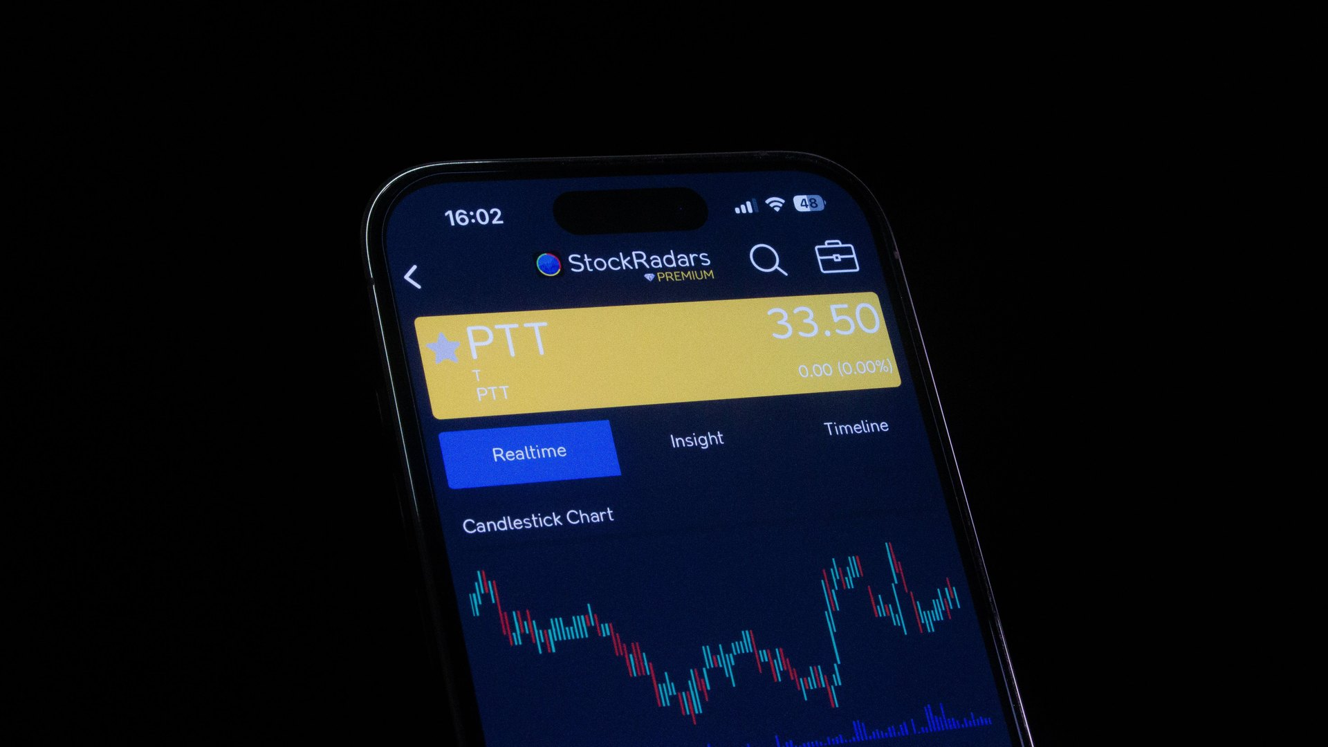
What is the trade mainly relying on?
HANDOUT · SPECULATION
09 / 21
Notes:
Do not classify from the image alone. Ask what the person expects to cause the profit. Move to speculation only when predicted price change is the main basis.
[Sources]
- Handout: Oehler-Huang Library, Investment Version 24 (local classroom source).
- Image: Pexels / StockRadars Co. — https://www.pexels.com/photo/smartphone-displaying-stock-trading-app-interface-28682345/
- Definition reference: FINRA Regulatory Notice 18-24 — https://www.finra.org/rules-guidance/notices/18-24
[/Sources]

Slide 10
PRICE PREDICTION
价格预测
main basis → speculation (投机)
HANDOUT · TEST THE RULE
10 / 21
Notes:
Students complete the rule aloud: if predicted price change is the main basis for the trade, classify it as speculation. Careful research does not automatically change that payoff source.
[Sources]
- Handout: Oehler-Huang Library, Investment Version 24 (local classroom source).
- Definition reference: FINRA Regulatory Notice 18-24 — https://www.finra.org/rules-guidance/notices/18-24
[/Sources]

Slide 11

What matters more than return?
HANDOUT · SAVING
11 / 21
Notes:
Ask students to infer the priorities of saving before reading the definition: keeping the amount available and limiting the chance of loss.
[Sources]
- Handout: Oehler-Huang Library, Investment Version 24 (local classroom source).
- Image: Wikimedia Commons / Ken Teegardin / CC BY-SA 2.0 — https://commons.wikimedia.org/wiki/File:Deposit_Into_Piggy_Bank_Savings_Account_(6093700157).jpg
- Definition reference: Investor.gov, Saving and Investing — https://www.investor.gov/additional-resources/general-resources/publications-research/info-sheets/saving-investing
[/Sources]

Slide 12
PRESERVATION
保本
LIQUIDITY
流动性
main priorities → saving (储蓄)
HANDOUT · COMPARE PRIORITIES
12 / 21
Notes:
Ask students to state the saving priorities aloud: capital preservation and liquidity. Interest does not automatically make saving an investment.
[Sources]
- Handout: Oehler-Huang Library, Investment Version 24 (local classroom source).
- Definition reference: Investor.gov, Saving and Investing — https://www.investor.gov/additional-resources/general-resources/publications-research/info-sheets/saving-investing
[/Sources]

Slide 13
INVESTMENT
投资
SPECULATION
投机
SAVING
储蓄
Three categories. One main purpose.
HANDOUT · COMPARISON GRID
13 / 21
Notes:
Use the page 1 grid. Stress that the same financial product can sometimes be used for different purposes; classify the decision by its main purpose and basis.
[Sources]
- Handout: Oehler-Huang Library, Investment Version 24 (local classroom source).
- Definition reference: Investor.gov, Introduction to Investing — https://www.investor.gov/introduction-investing
- Definition reference: FINRA Regulatory Notice 18-24 — https://www.finra.org/rules-guidance/notices/18-24
- Definition reference: Investor.gov, Saving and Investing — https://www.investor.gov/additional-resources/general-resources/publications-research/info-sheets/saving-investing
[/Sources]

Slide 14
HANDOUT · PAGE 2
A–D
Classify. Cite one decisive clue.
PAIRS · 3 MINUTES
14 / 21
Notes:
Students complete cases A–D. Cold-call: category first, then the exact clue. Press for why the nearest alternative is weaker.
[Sources]
- Handout: Oehler-Huang Library, Investment Version 24 (local classroom source).
[/Sources]

Slide 15
HANDOUT · PAGE 2
E–J
Classify. Reject one nearby category.
PAIRS · 5 MINUTES
15 / 21
Notes:
Students complete cases E–J. Require a boundary statement: not saving because..., or not investment because....
[Sources]
- Handout: Oehler-Huang Library, Investment Version 24 (local classroom source).
[/Sources]

Slide 16
ONE ANSWER
ONE REASON
Explain why one distractor is wrong.
HANDOUT · PAGE 3
16 / 21
Notes:
Students answer the five multiple-choice questions independently. For one question, they must explain why a tempting distractor is wrong.
[Sources]
- Handout: Oehler-Huang Library, Investment Version 24 (local classroom source).
[/Sources]

Slide 17
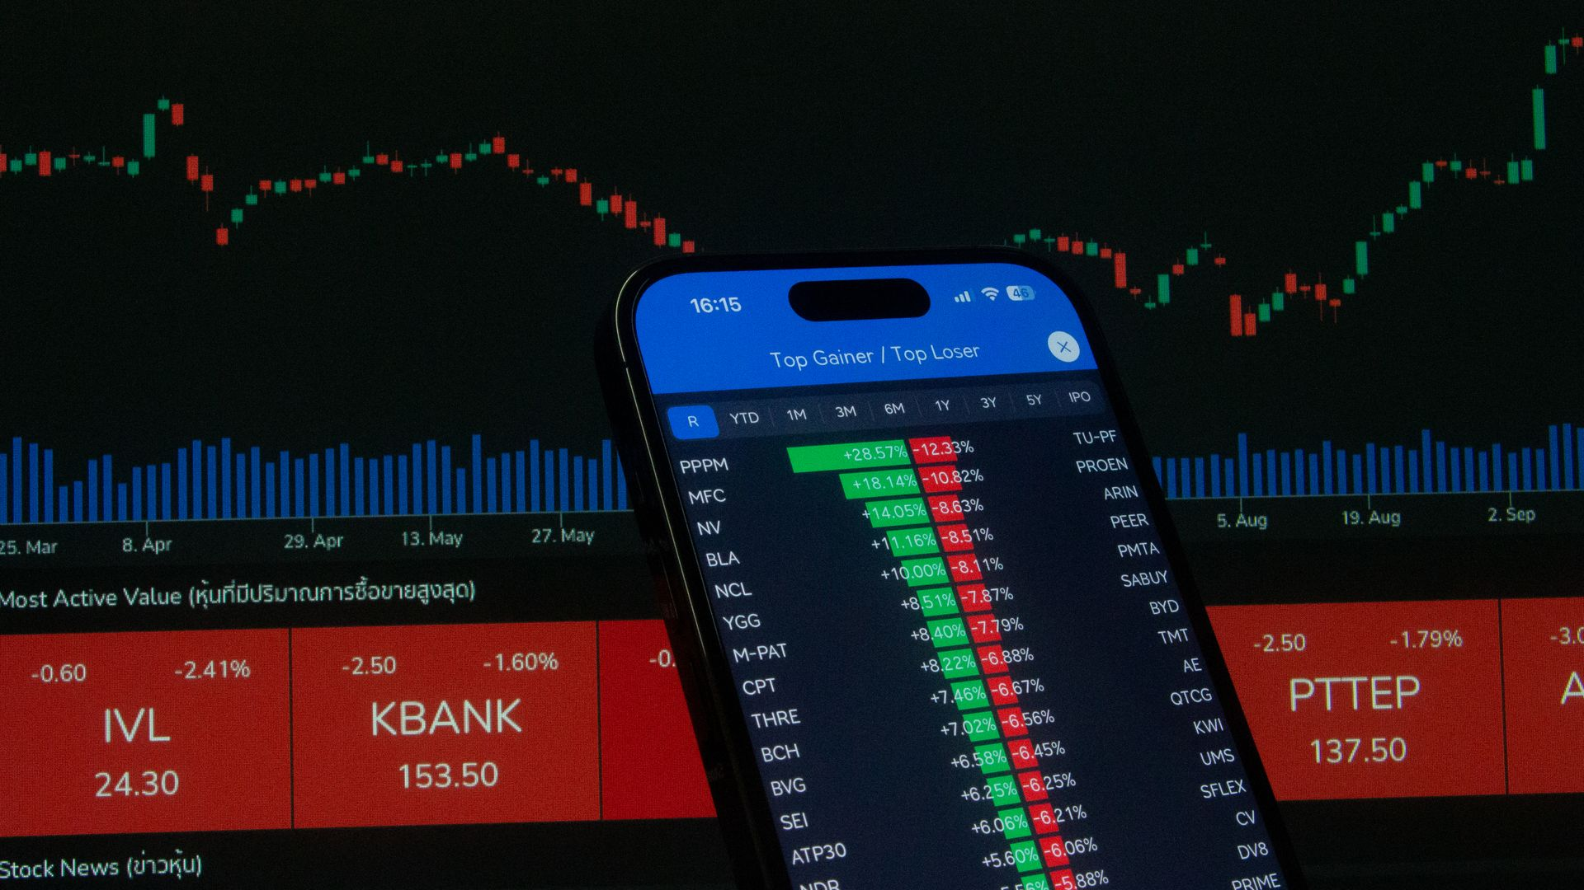
Same asset. Same decision?
PURPOSE AND BASIS DECIDE
RETURN TO THE HOOK
17 / 21
Notes:
Revisit the opening question. Students should now say that an asset name alone is insufficient; the main purpose and basis of expected return determine the category.
[Sources]
- Handout: Oehler-Huang Library, Investment Version 24 (local classroom source).
- Image: Pexels / StockRadars Co. — https://www.pexels.com/photo/smartphone-displaying-stock-market-data-28682351/
[/Sources]

Slide 18
WHEN NEEDED?
CAN LOSS BE AFFORDED?
Mina + Leo
HANDOUT · PAGE 4
18 / 21
Notes:
Short answers have no projected case text because it is on the handout. Students answer Mina and Leo using emergency fund, time horizon, liquidity, capital preservation and possible loss.
[Sources]
- Handout: Oehler-Huang Library, Investment Version 24 (local classroom source).
[/Sources]

Slide 19
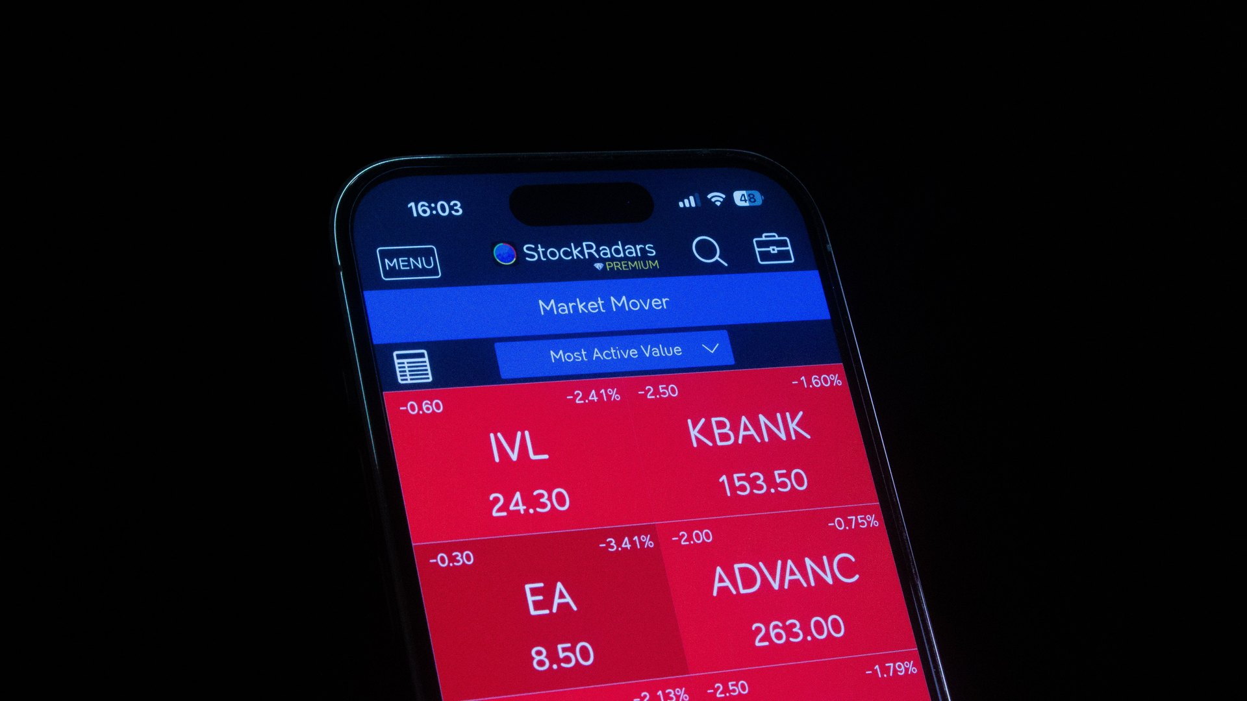
The price falls. What remains?
HANDOUT · NORA
19 / 21
Notes:
Students read Nora's case. Elicit that a share-price loss does not cancel the debt.
[Sources]
- Handout: Oehler-Huang Library, Investment Version 24 (local classroom source).
- Image: Pexels / StockRadars Co. — https://www.pexels.com/photo/smartphone-display-of-stock-market-application-28682350/
[/Sources]

Slide 20
BORROWED MONEY
借入资金
REPAYMENT REMAINS
偿还义务
Borrowing magnifies possible loss (可能亏损).
NOTEBOOK · ONE RULE
20 / 21
Notes:
Students write: Borrowing can magnify loss because the repayment obligation remains even when the asset price falls.
[Sources]
- Handout: Oehler-Huang Library, Investment Version 24 (local classroom source).
[/Sources]

Slide 21
CATEGORY
CLUE
BOUNDARY
One sentence. Three parts.
EXIT · NOTEBOOK
21 / 21
Notes:
Exit sentence: classify one new example, cite the decisive clue, and distinguish it from the nearest alternative. Collect or sample notebooks before students leave.
[Sources]
- Handout: Oehler-Huang Library, Investment Version 24 (local classroom source).
[/Sources]

